Slide 1

Developers & Domain
Nitin Babariya
Betsson Dev’Talk #4
Stockholm – 23rd May 2019

Slide 2
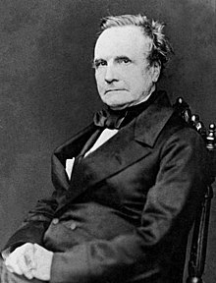
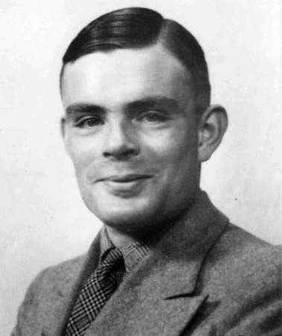
Developers
are artists
do creative & innovative work
deliver business value
using code as tool
Charles Babbage
Alan Turing

Slide 3
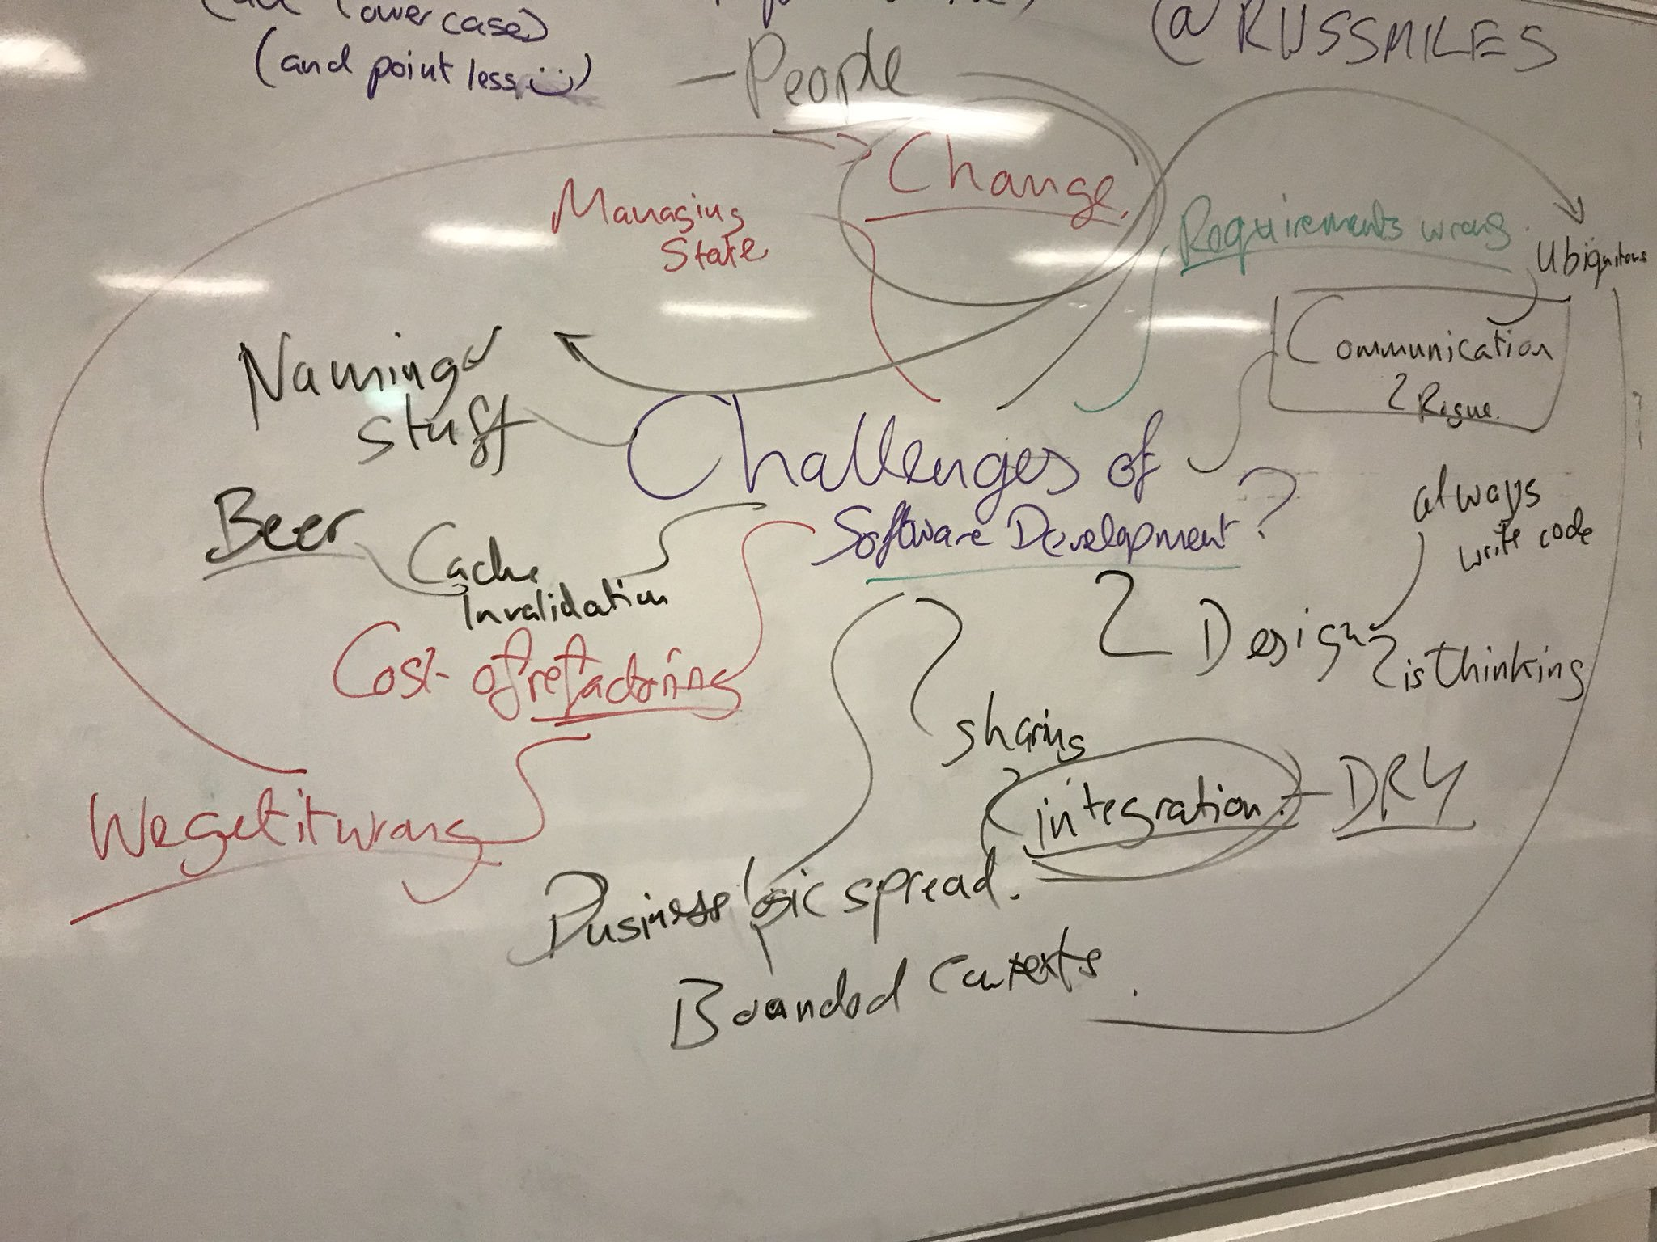
Challenges of software development

Slide 4
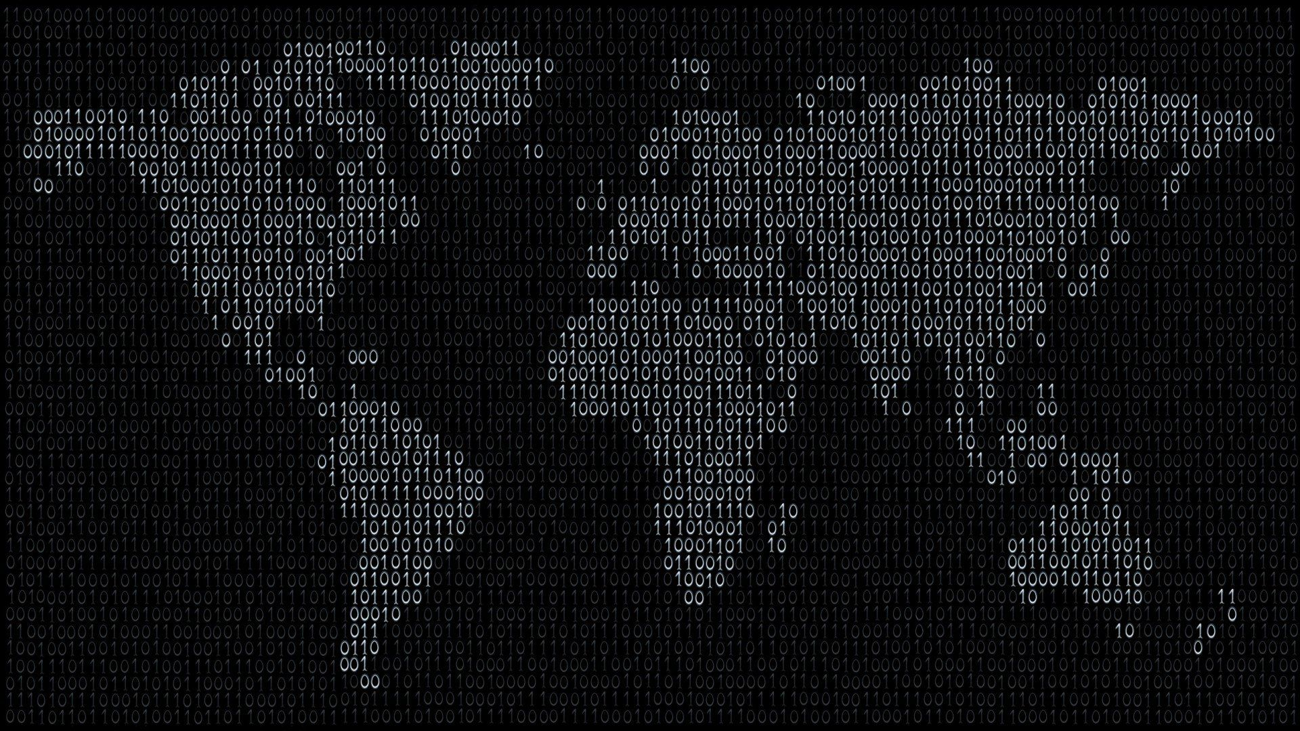
Software is eating up world
Software is eating up world

Slide 5

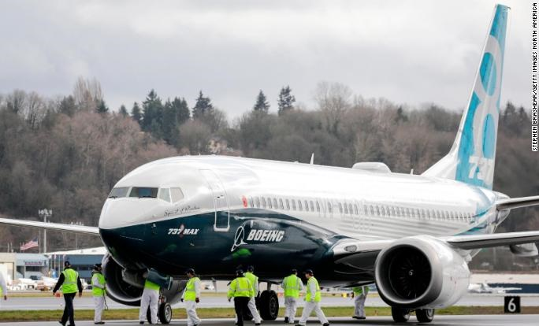
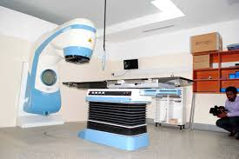
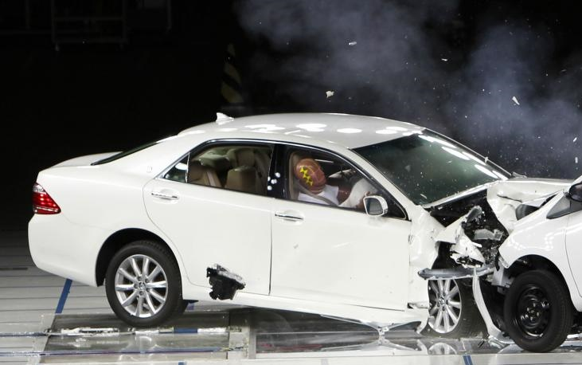
There will be more bad days
Software did what it was exactly being told
Flexibility is software’s miracle, and its curse
Sloppy shortcuts under schedule pressure
Because it can be changed cheaply, software is constantly changed

Slide 6
I've been doing this for thirty-six years.
I've read hundreds of accident reports and many of them have software in them.
And every someone (sic) that software was related, it was a requirements problem.
It was not a coding problem. So that's the first really important thing.
Everybody's working on coding and testing and they're not working on the requirements, which is the problem.
-Nancy Leveson – Expert in safety – critical systems from MIT

Slide 7
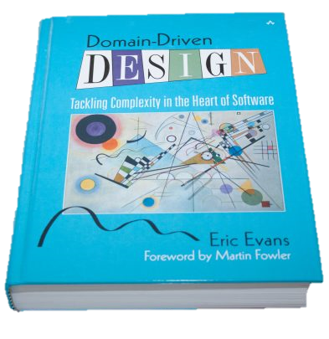
DDD = Communication + ⨐OOPs (business domain)
Its suitable for complex domain
Bounded context, aggregates and many more unfamiliar concepts.
You need to do it the right way
You need to write lots of code
You need to design realistic model

Slide 8

Design work!

Slide 9
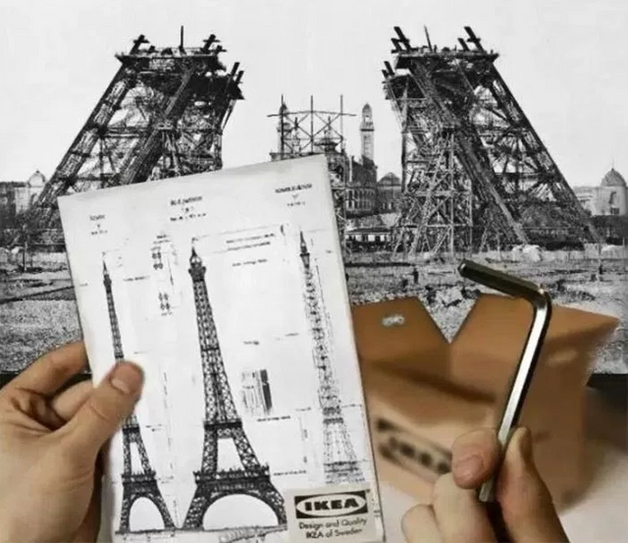
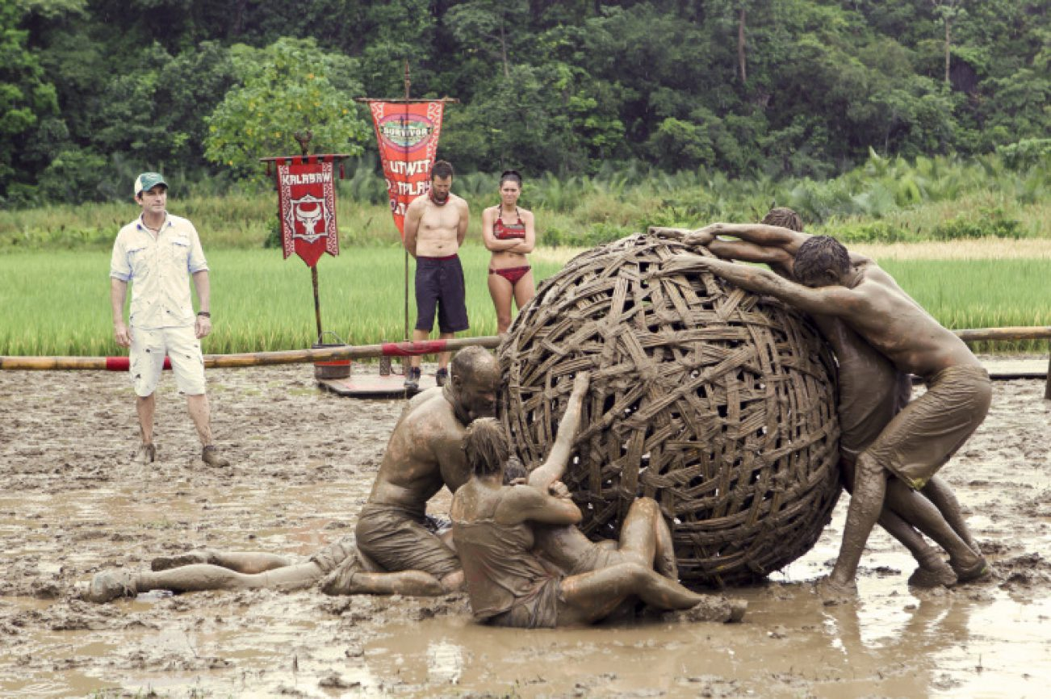
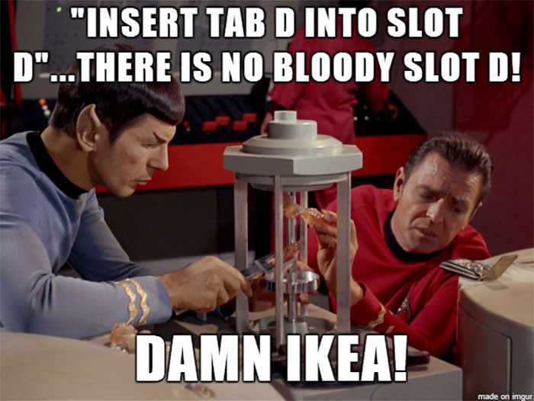
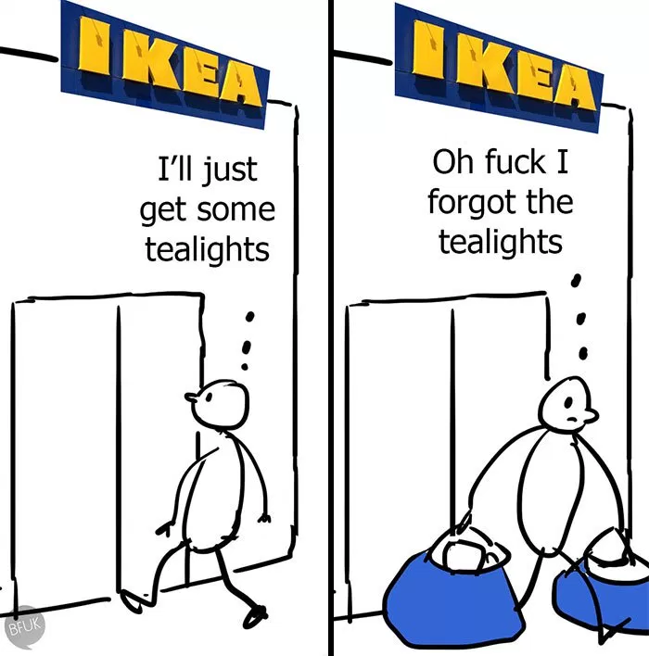
Design
fcuk

Slide 10
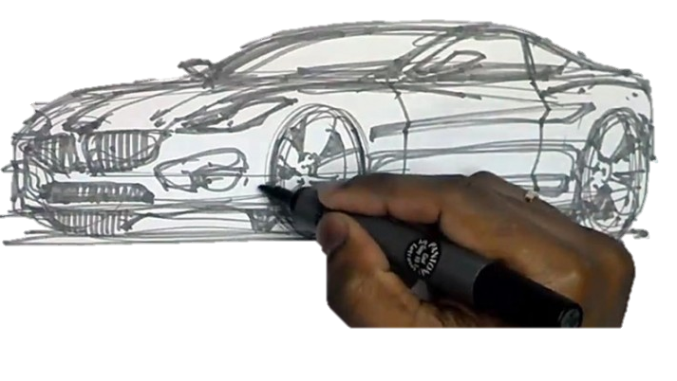
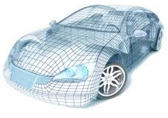
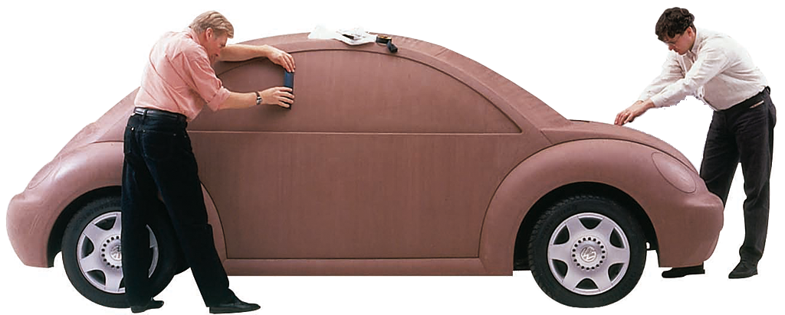
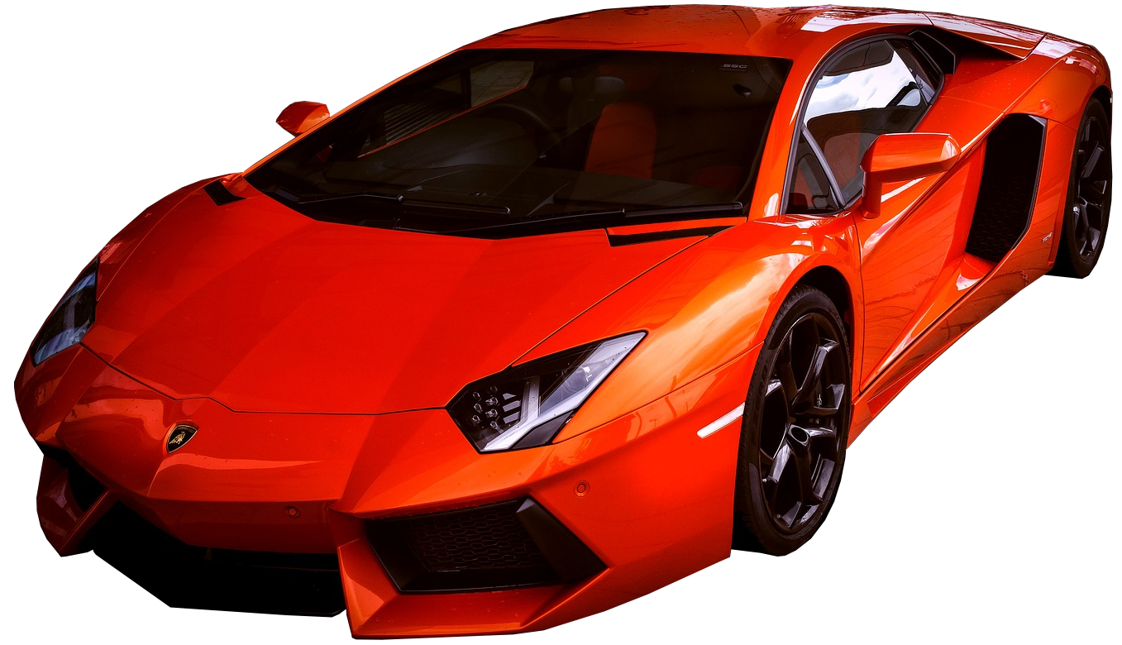
Domain modeling is iterative

Slide 11
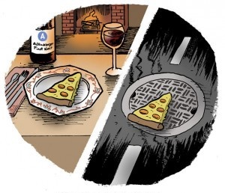

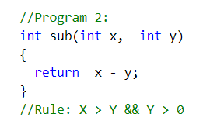
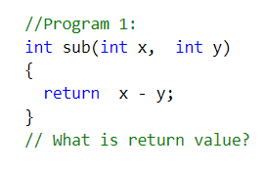
Context is the king

Slide 12

The lost person in balloon

Slide 13

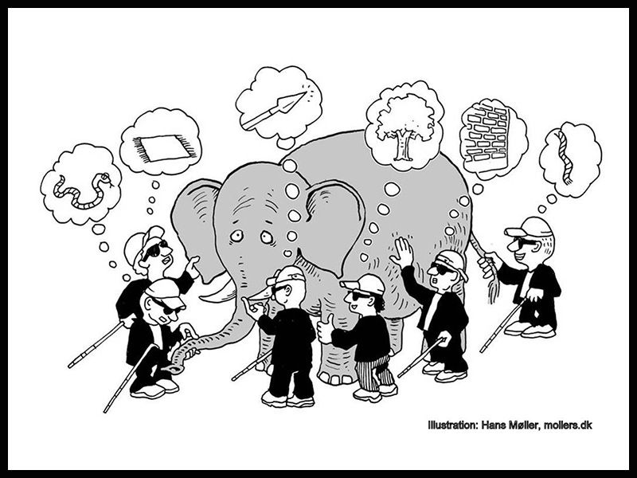
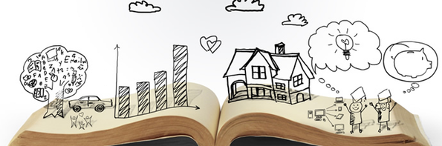
Ubiquitous language
Examples:
Military time
British vs US imperial unit of measurements
Gallon, Ounce, Pint, Quart
Create booking --> Register/Accept booking
Delete booking --> Cancel booking
Submit order --> Checkout
Set status --> Cancelled, Shipped, Delivered
Tell a story
Discuss with examples
Build vocabulary
Define a very clear & precise language
Experts may not know everything

Slide 14
Finance & accounting Context
Shipping context
Customer Context
Shipping context
Shipping context
Shipping context
Sales Context
Sales Context
Shipping context
Sales Context
Shipping context
Customer Context
Sales Context
Finance & accounting Context
Shipping context
Shipping context
Monolithic API

Slide 15
Define bounded context

Slide 16
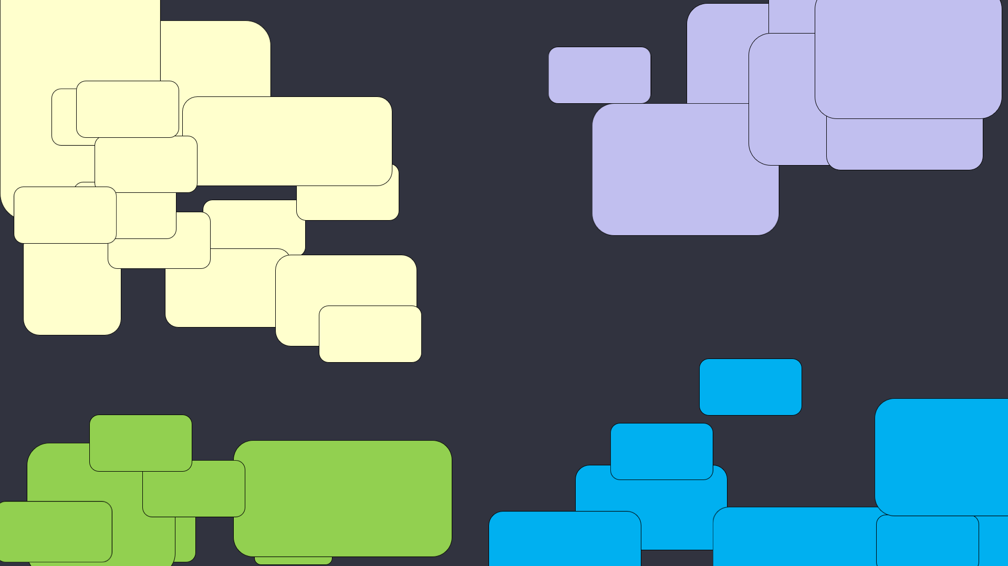
Sales Context
Customer Context
Finance & accounting Context
Shipping context

Slide 17
Sales Context
Customer Context
Context Map
Finance & accounting Context
Shipping context

Slide 18
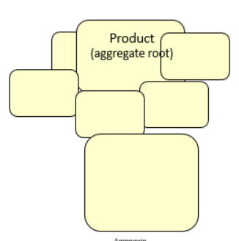
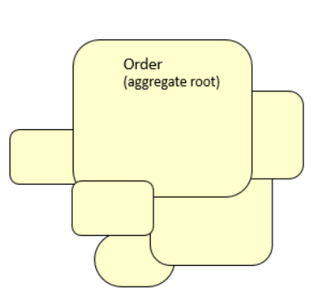
Aggregates
Sales Context
Global identity
Entity
Entity
References Aggregate root ID
Value Object
Entity
Entity
Entity
Have local Identity
Cluster of objects
Single transaction
Separate transaction
Design small aggregate
Satisfy Invariants on Pre or post invocation

Slide 19
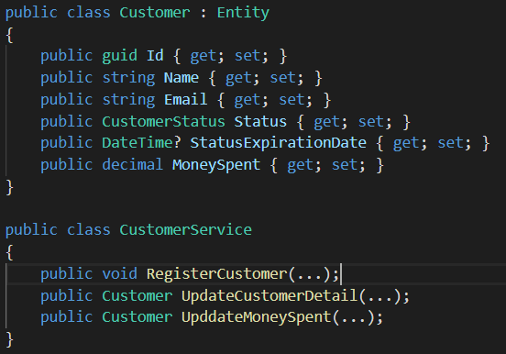
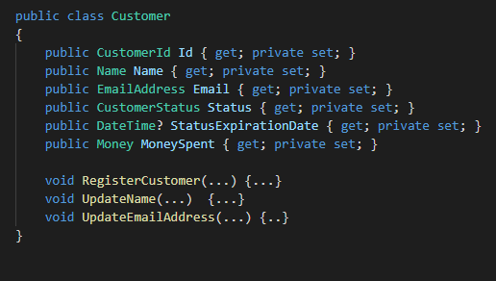
Build rich domain model

Slide 20


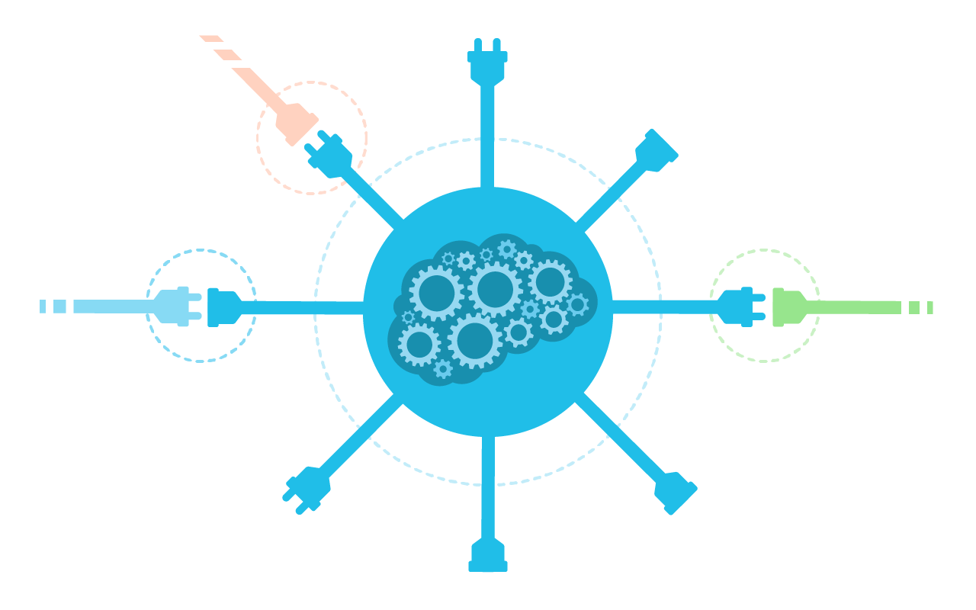




Anti-corruption layer
Legacy system
Create isolation between different semantics
Ditch legacy
Don’t let external noise ruin your peace
For example.
ApriContoPersonaFisica(..) → RegisterCustomerAccount (..)
StatoConto(..) → GetCustomerAccountStatus(..)
BI
Customer registration API

Slide 21
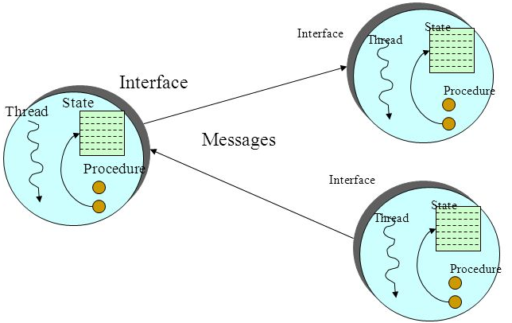


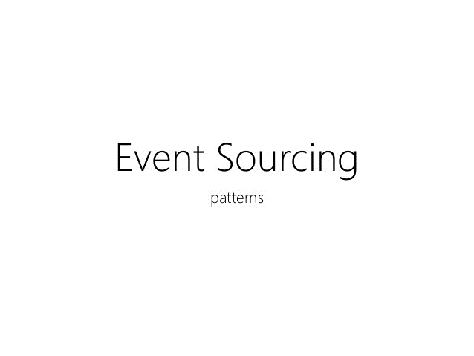



Different implementation approaches
Git
Account ledger
Bank statement
It works fine
Its a powerful tool
Functions,
sequences,
maps
Graph database,
nodes ,
edges,
fuzzy approximate,
etc..
Scalability & Performance
Resilience
Maintainability

Slide 22
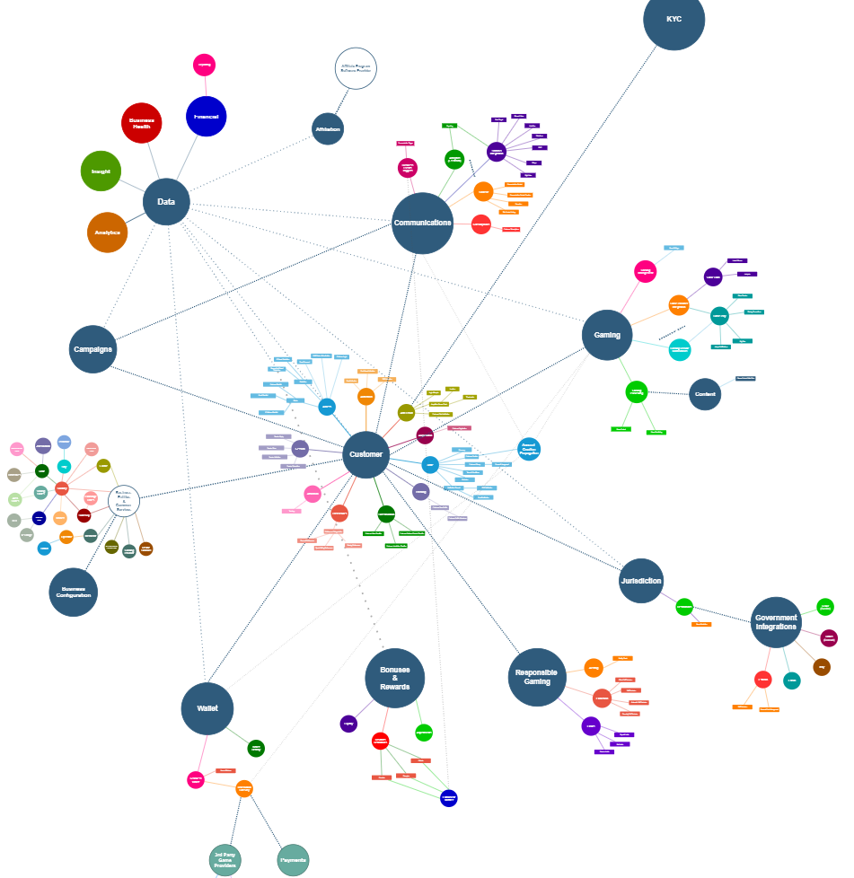

Slide 23


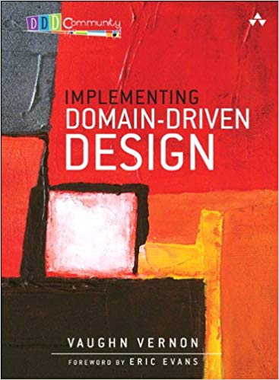
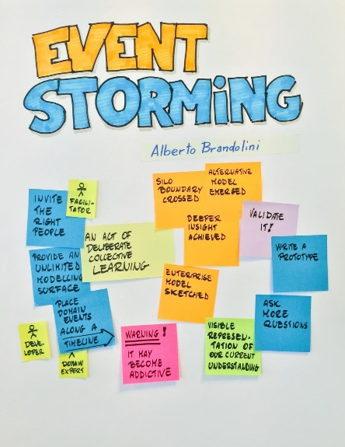

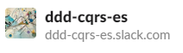
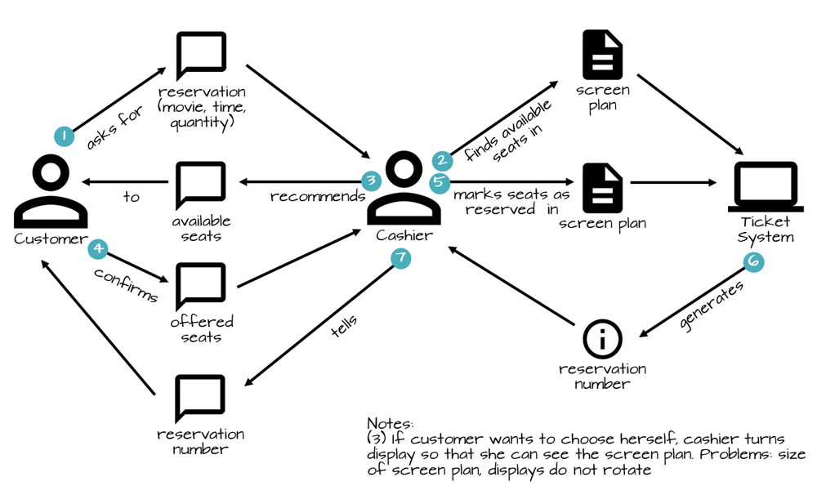


Good stuff…
EventFlow
geteventflow.net
A workshop
Eg. miro.com
Java world
axoniq.io
github.com/WPS/domain-story-modeler

Slide 24
the secret ingredient

Slide 25

“there is no secret ingredient”

Slide 26
this is how I see DDD, how about you?
Please share Your experiences
Your journey
Lesson learned
Questions
and the rest

Slide 27
Thank you!
NITIN BABARIYA
Developer
Techsson, Betsson
@Nitinbabariya
nitin.babariya@betssongroup.com

